Slide 1



PE Options at The Hollins
Discover Your Potential Through Sport!

Slide 2
Why Choose a Sports Course?
Choosing a sports course offers incredible benefits for pupils and reassurance for parents:
Builds confidence and resilience through physical challenges.
Promotes health, fitness, and lifelong well-being habits.
Develops teamwork, leadership, and communication skills.
Opens doors to exciting careers in sport, health, and education.
Encourages discipline, motivation, and goal-setting — skills that last a lifetime.

Slide 3
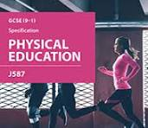
Why Choose OCR GCSE PE?
A dynamic blend of science, performance and real-world sport!
  Perfect for pupils who LOVE understanding how elite athletes succeed.
  Showcase your talent: perform at a HIGH level in THREE activities!
  One must be an individual sport – shine on your own stage!
  External sports like dance, swimming or horse riding are recognised!
  Assessment: 60% theory, 30% practical, 10% coursework.
  TWO exams where you apply your sporting knowledge.
  Great for confident performers ready to inspire others!

Slide 4
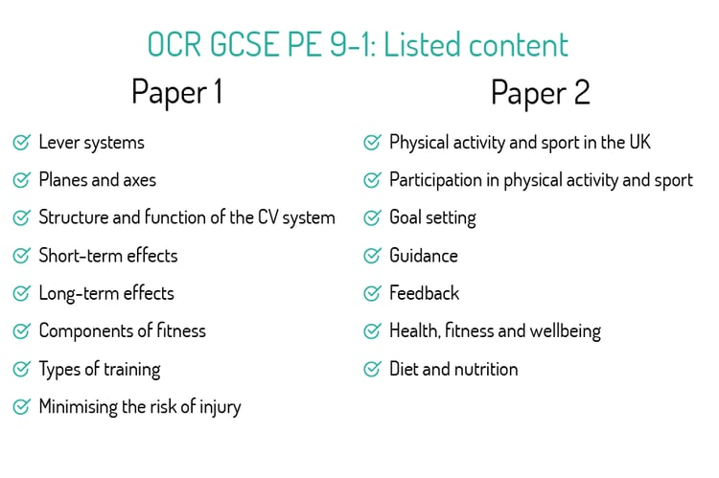
GCSE PE: Theory Details
Theory accounts for 60%.
3 out of 5 lessons per fortnight are theory-based.
Two 1-hour exams:
Paper 1: Physical factors affecting performance (Applied anatomy, physiology, physical training).
Paper 2: Socio-cultural issues & Sports Psychology (Influences, Psychology, Health).

Slide 5
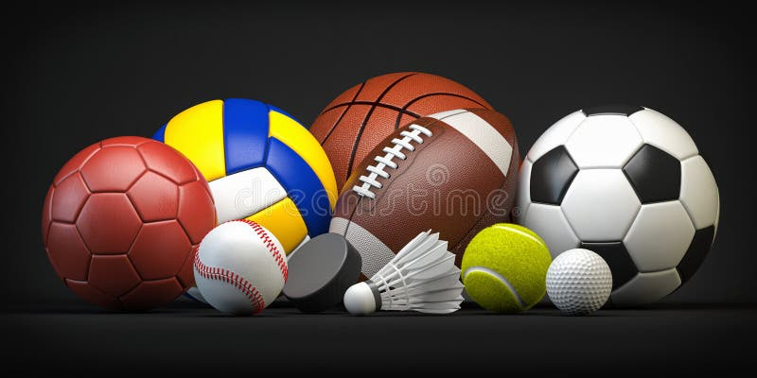
GCSE PE: Practical Details
Practical accounts for 30%.
Assessed in 3 sports: 1 team, 1 individual, and 1 other.
Students must play competitively in these sports, including external activities like swimming, gymnastics, horse riding.

Slide 6
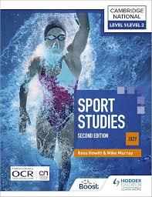
Why Choose Cambridge National Sports Studies?
Hands-on, practical and perfect for active learners!
  More coursework, less exam pressure – succeed through consistent effort.
  Take the lead with sports leadership tasks – become the coach!
  Fantastic for pupils who enjoy teamwork, creativity and real-world tasks.
  Build confidence through practical performance and leading sessions.
  Ideal for pupils who want to develop skills used in sports careers.

Slide 7
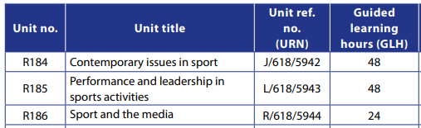
Sports Studies: Unit Breakdown
Unit 1: Exam on Contemporary Issues in Sport.
Unit 2: Practical and coursework on performance and leadership.
Unit 3: Coursework on Media and Sport.

Slide 8
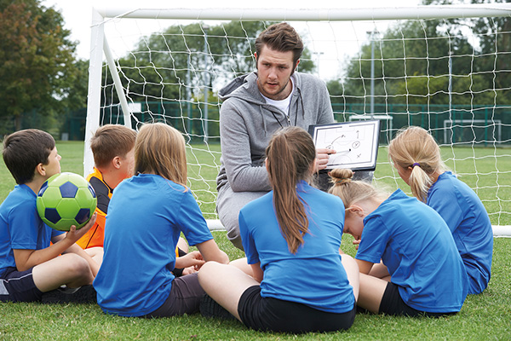
Sports Studies: Course Overview
Cambridge National in Sport Studies focuses on officiating, leadership, and understanding the impact of sport on society.
Students explore contemporary issues and different roles in the sports industry.

Slide 9
What We Expect from You
A genuine passion for sport – inside AND outside school!
  GCSE PE: strong performance across 3 sports including an individual event.
  Confidence to perform in front of others and push yourself to improve. (lessons are mixed)
  Sports Studies: enthusiasm to lead, organise and motivate your peers.

Slide 10
Your Next Steps After Year 11
A-level PE for aspiring sports scientists or teachers.
BTEC Level 3 Sport for practical and applied learning.
Sports apprenticeships for hands-on experience.
College sport academies for performance-focused pathways!

Slide 11
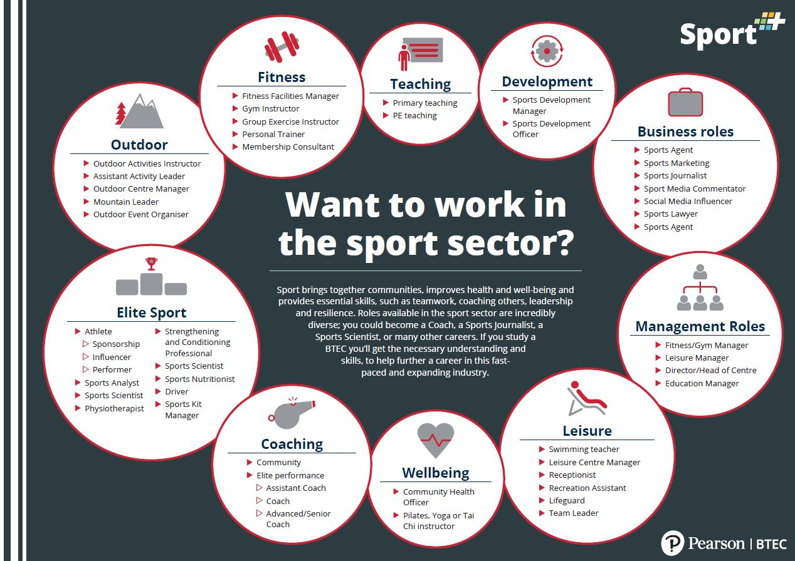
Exciting Future Careers
PE teacher, sports coach or fitness instructor.
Physiotherapist, sports therapist, or personal trainer.
Sports journalism, officiating, performance analysis.
Outdoor education, public services and many more!

Slide 12
Which Pathway IS YOUR Perfect Fit?
GCSE PE – ideal for pupils who love science, analysis and performing at a high level.
Sports Studies – ideal for pupils who enjoy practical learning and leading others.
Both courses develop confidence, teamwork and leadership – skills that last a lifetime!

