Slide 1




Year 9 Options talk
Separate Science

Slide 2

Which Jobs/Careers Involve Science?

Slide 3
How did you get on?
Electrician, electronics engineer, satellite engineer, astronomer, power plant worker, architecture, CAD/CAM designer, computer science, network engineer, web designer, multimedia engineer, sound engineer, project manager, IT systems analysist, acoustics engineer, game designer, city planner, clinical scientist, ecologist
food scientist/technologist, forensic scientist, geologist, nanotechnologist, vet, doctor, sport nutritionist, pilot.....................................................

Slide 4
How did you get on?
Did you get any non-obvious ones?
Hairdresser
Banker
Architect
Gardener
Builder
Computer programmer
Leisure centre manager
The possibilities are endless!
Click here for more information on careers in science

Slide 5
Comparing separate and combined science
 | Combined Science | Separate Sciences
Lessons per fortnight in years 10 & 11 | 10 | 15
Number of GCSEs gained | 2 | 3
Number of exams | 6 | 6
Length of each exam | 1 hr 15 | 1 hr 45

Slide 6

What is the ‘extra’ content?
Separate science allows students the opportunity to study topics in more detail. Extra topics are also included; for example, Space is taught in GCSE Physics but not Combined Science. This is important to consider for future studies at A-level and university

Slide 7
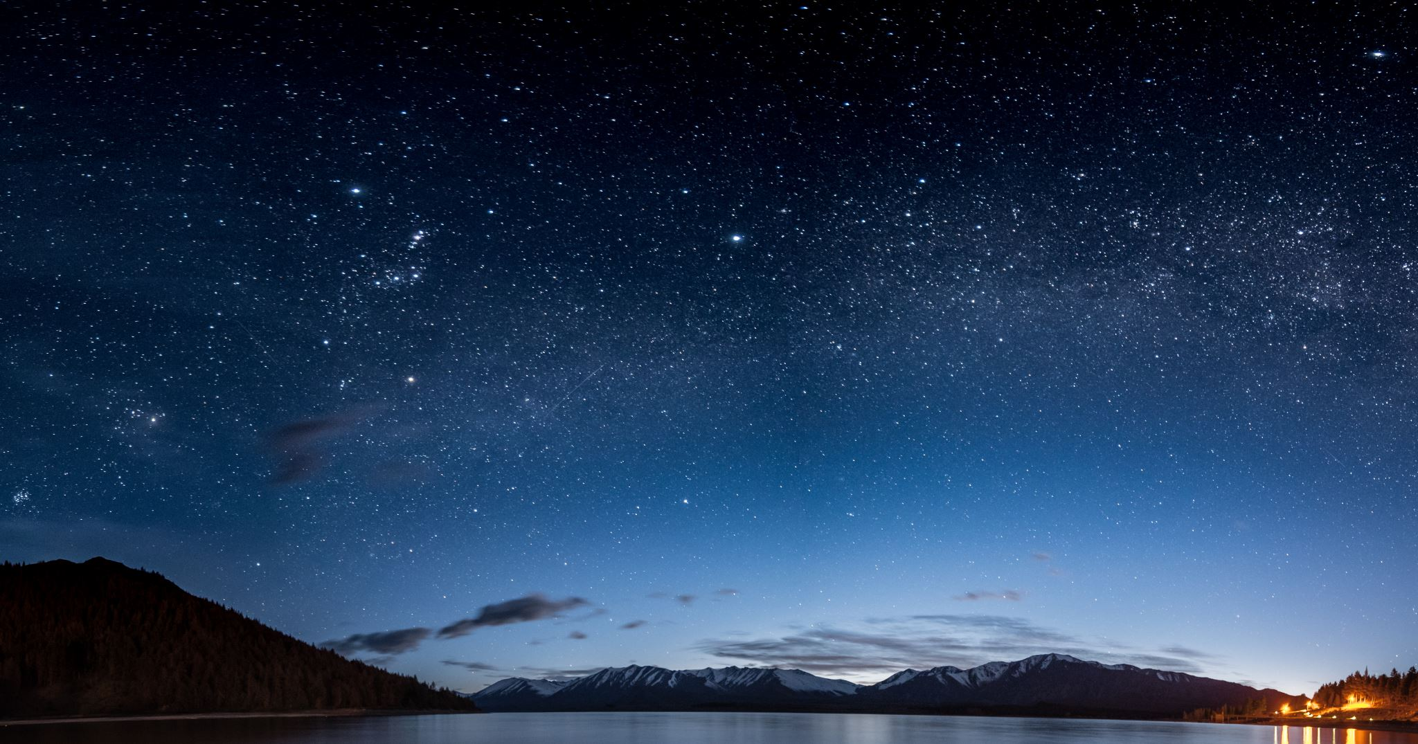
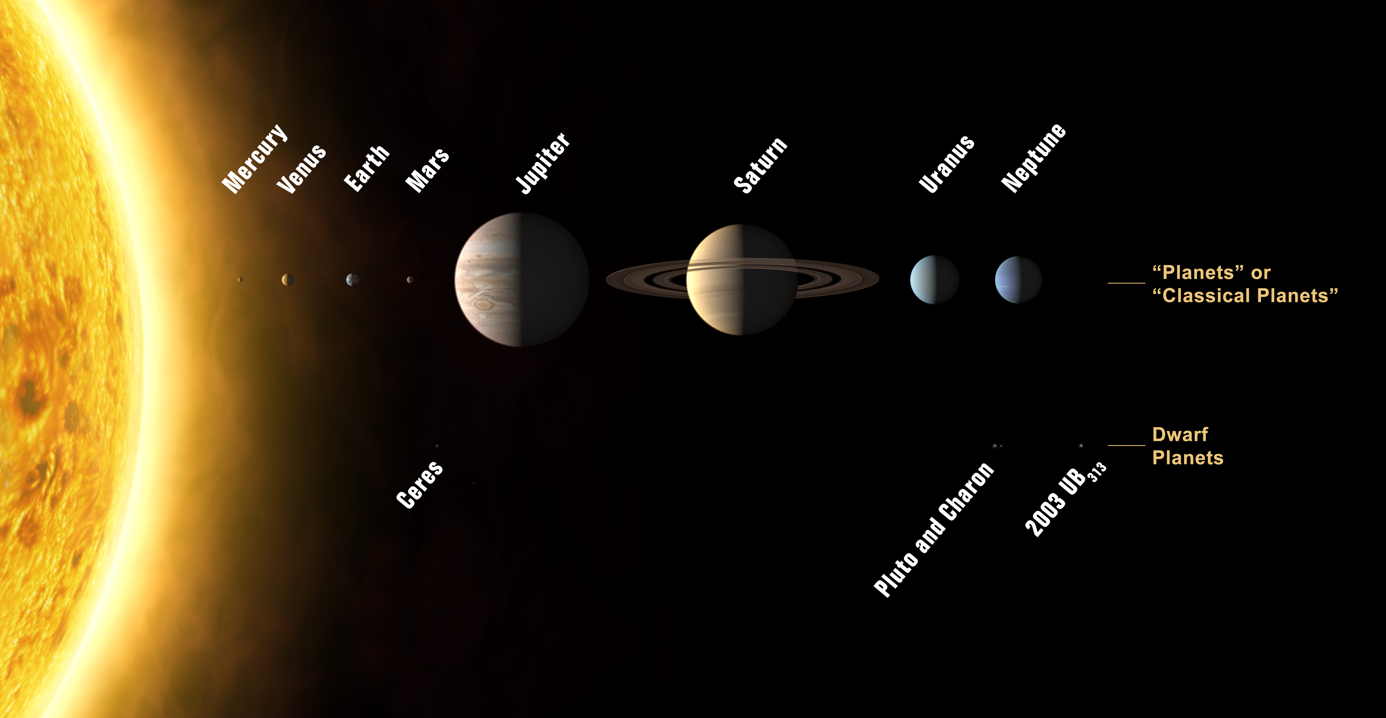
GCSE Physics Space topic:
The solar system:

Slide 8

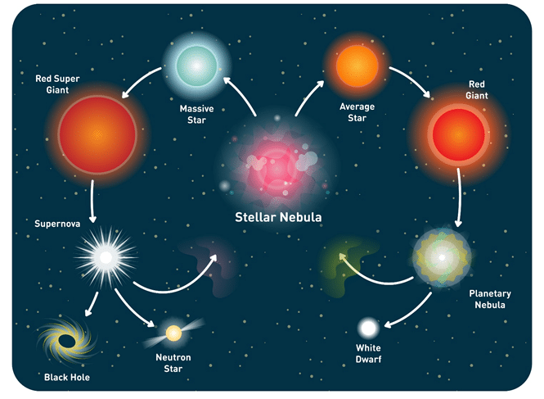
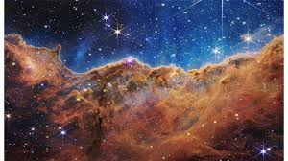
GCSE Physics Space topic:
The life cycle of stars
The carina nebula taken by the James Webb Telescope

Slide 9
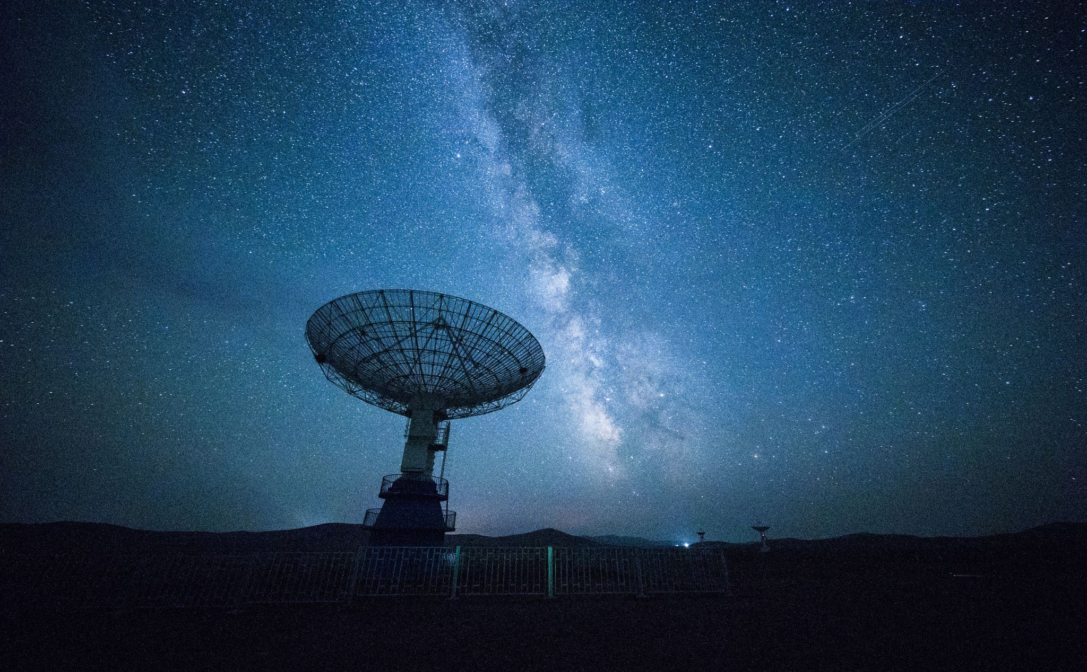
GCSE Physics Space topic:
The Big Bang Theory and Red Shift

Slide 10
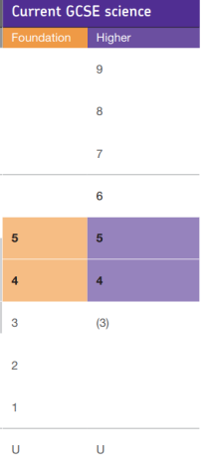
Students may be entered into different tiers for the different subjects, e.g. a student could take Higher Tier papers for Biology and Chemistry and a Foundation Tier paper for Physics.
In combined science, students must take the same tier for all three
The Foundation tier goes all the way up to a grade 5 for Biology, Chemistry and Physics or 5-5 for Combined Science. Previously the Foundation tier of all Science GCSEs was capped at a grade C. Similarly, the Higher tier now only goes down to a grade 4 for Biology, Chemistry and Physics or a 4-4 for Combined Science as opposed to the previous grade D.

Slide 11

Why should I choose separate science?
I enjoy science
I’m good at science
I want to study science subjects at A level
I want to pursue a career in science

