Slide 1
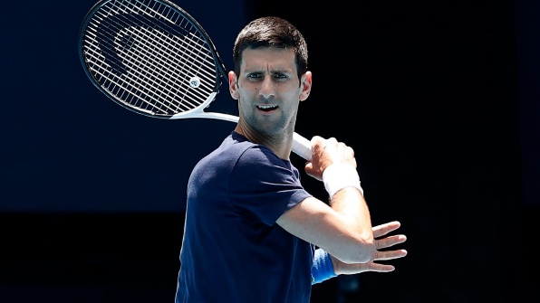






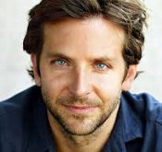









What do all these people have in common?

Slide 2
What do all these people have in common?
They can all speak more than one language!

Slide 3



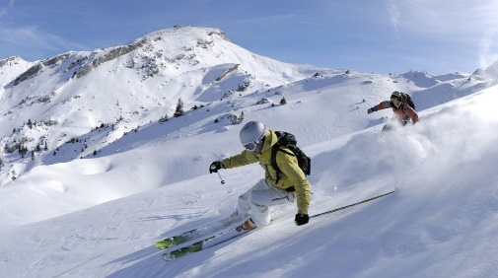


Why take French or Spanish for GCSE?

Slide 4
Why take French or Spanish for GCSE?
Speaking another language increases your chances of meeting friends across the world

Slide 5

Why take French or Spanish for GCSE?
Speaking another language increases your chances of meeting friends across the world
Mental benefits of
learning languages

Slide 6
Why take French or Spanish for GCSE?
Speaking another language increases your chances of meeting friends across the world
Mental benefits of
learning languages
Students who study a foreign language do better than their classmates in exams – it actually makes you more intelligent!

Slide 7
Why take French or Spanish for GCSE?
75% of the world’s population does not speak English at all
Speaking another language increases your chances of meeting friends across the world
Mental benefits of
learning languages
Students who study a foreign language do better than their classmates in exams – it actually makes you more intelligent!

Slide 8

Why take French or Spanish for GCSE?
75% of the world’s population does not speak English at all
Speaking another language increases your chances of meeting friends across the world
Benefits of speaking a language when travelling
Mental benefits of
learning languages
Students who study a foreign language do better than their classmates in exams – it actually makes you more intelligent!

Slide 9
Why take French or Spanish for GCSE?
75% of the world’s population does not speak English at all
Speaking another language increases your chances of meeting friends across the world
Benefits of speaking a language when travelling
Mental benefits of
learning languages
Over 1/3 of businesses want people specifically for their language skills
Students who study a foreign language do better than their classmates in exams – it actually makes you more intelligent!

Slide 10
Why take French or Spanish for GCSE?
75% of the world’s population does not speak English at all
Speaking another language increases your chances of meeting friends across the world
Benefits of speaking a language when travelling
Mental benefits of
learning languages
Over 1/3 of businesses want people specifically for their language skills
Students who study a foreign language do better than their classmates in exams – it actually makes you more intelligent!
People with a language can expect a 20% increase in salary in certain jobs

Slide 11
You will be the third year group to do the NEW GCSE French and Spanish course. It is more accessible and manageable than the old one.
You have already specialised in one language since Year 7 – only our second year group to ever do this!
Our department has been praised for high levels of speaking in class. This makes you more able, confident learners than in other schools!

Slide 12



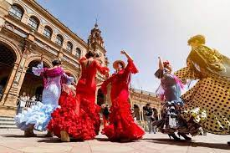





Course content
What you’ll study:
1) People and lifestyle
2) Popular culture
  3) Communication and the world around us

Slide 13




Exam
3 written exams and one speaking assessment
Either Foundation (grades 1-5) or Higher (grades 4-9) tier
25%
25%
25%
25%

Slide 14
Do you…
…have high aspirations?
…want to stand out when applying for jobs and colleges?
…want to earn more in your chosen career when you’re older?
…want to leave school with a real life skill you can use for the rest of your life?
… want to have the best chance of getting into the top universities in the country?
…want to travel and see more of the world?
Then French or Spanish GCSE is for you!

Slide 15
Careers where languages are used
•Business services
•Central Government
•Construction
•Creative and Media
•Engineering
•Event management
•Financial services
•Hair and Beauty
•Health, Medicine and Social Care
•Hotel and Catering management
•Land-based and Environmental work
•Law
•Local Government
•Manufacturing
•Marketing
•The Military
•Public services
•Retail
•Teaching
•Technology and computer gaming
•Translation and Interpreting
•Travel and tourism
•Voluntary and charitable sector

Slide 16






