Slide 1



GCSE HISTORY!

Slide 2
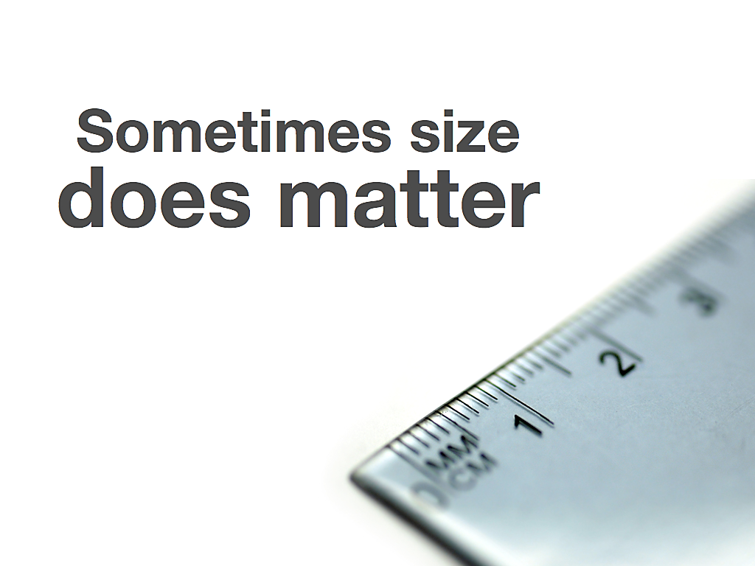
SOMETIMES SIZE
does matter!

Slide 3
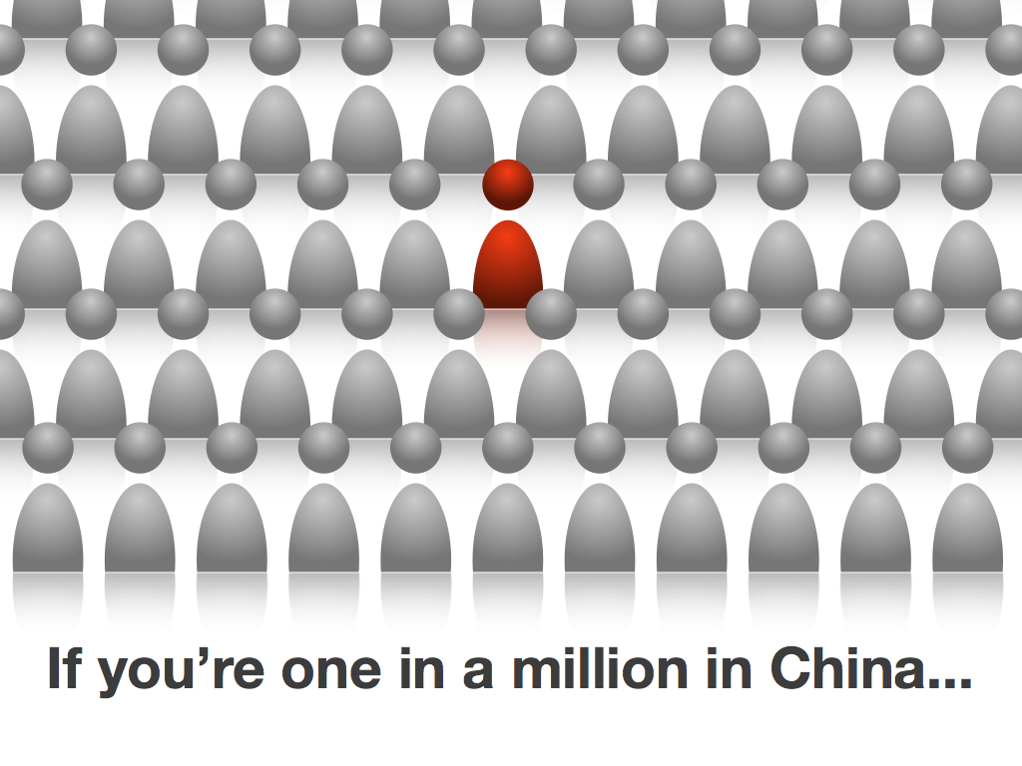
If YOU are interested in studying GCSE HISTORY…

Slide 4

…then there are +160 PUPILS at this school just like YOU!

Slide 5

That’s MORE than the total number of PEOPLE sitting in this HALL…

Slide 6

…MORE than the total number of HISTORY LESSONS you have in Year 9…

Slide 7
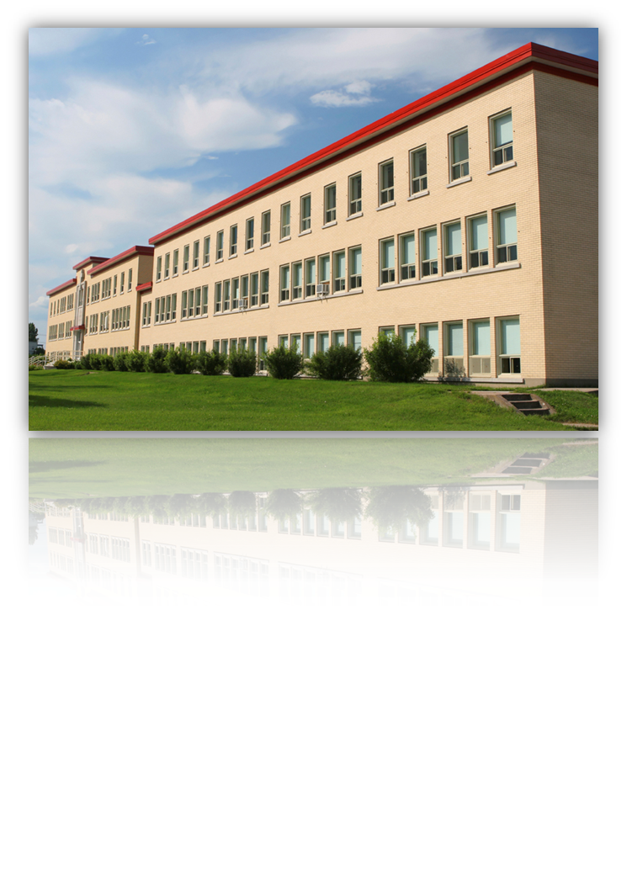
…MORE than any other school in ACCRINGTON!

Slide 8

TRANSLATION?
More pupils choose to study GCSE HISTORY at THE HOLLINS in YEAR9 than anywhere else… FACT!

Slide 9


Slide 10
AT GCSE HISTORY LEVEL
you will study…

Slide 11
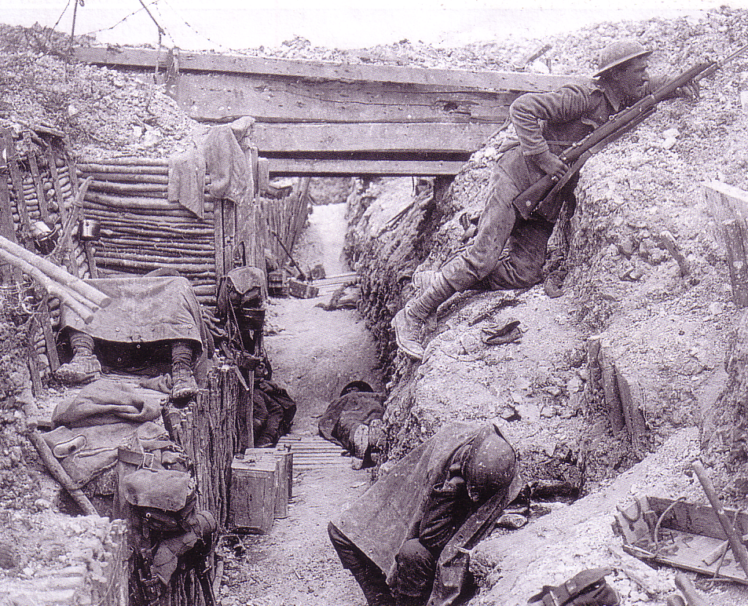
World War 1!

Slide 12
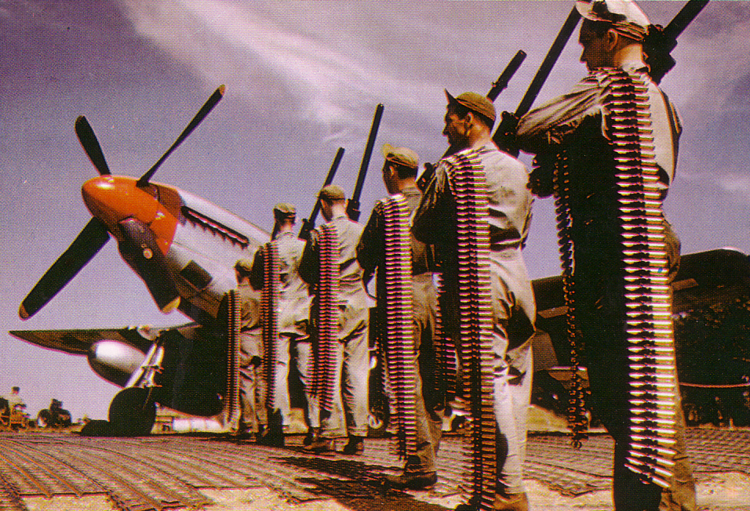
World War 2!

Slide 13
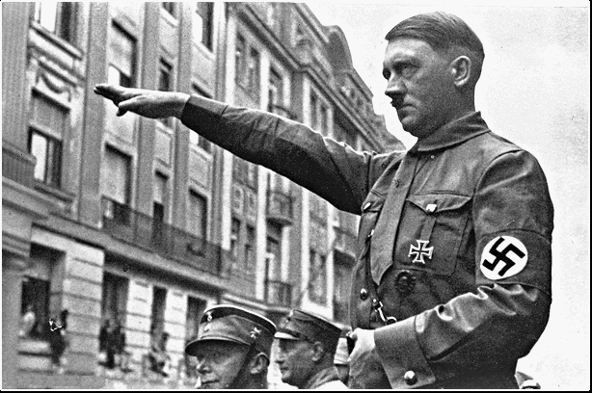
Hitler & Nazis!

Slide 14
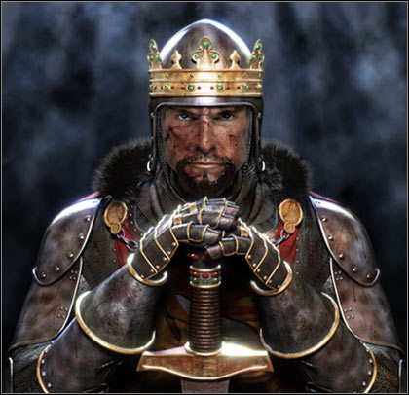
Infamous Medieval Kings!

Slide 15
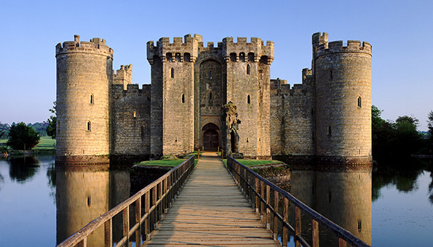
Grand Medieval Castles!

Slide 16
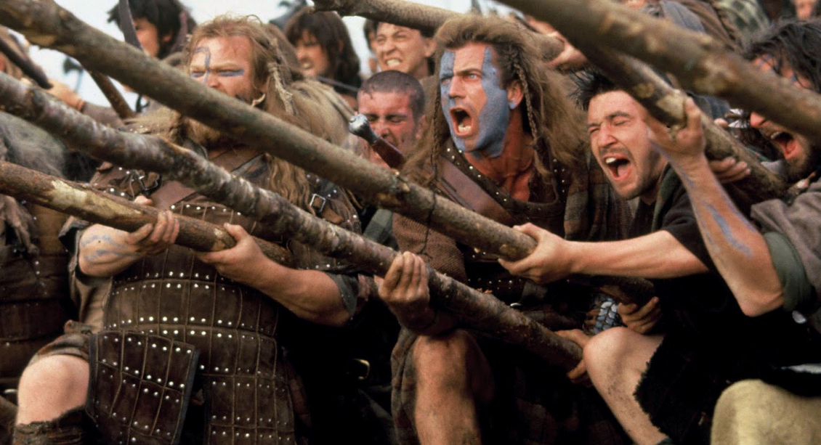
Bloody Medieval Battles!

Slide 17
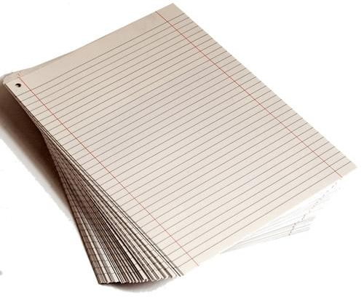

2 EXAMS END YEAR 11
PAPER 1 50%
PAPER 2 50%

Slide 19
GCSE HISTORY
is useful in many different jobs….

Slide 20
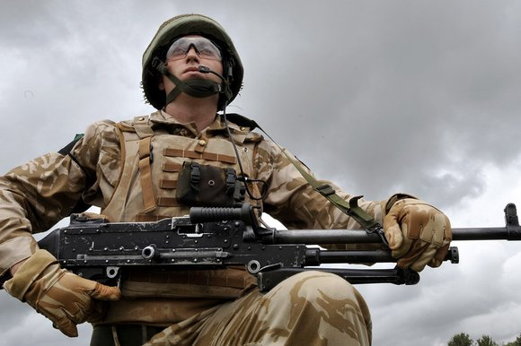
Armed Forces!

Slide 21

Teacher!

Slide 22
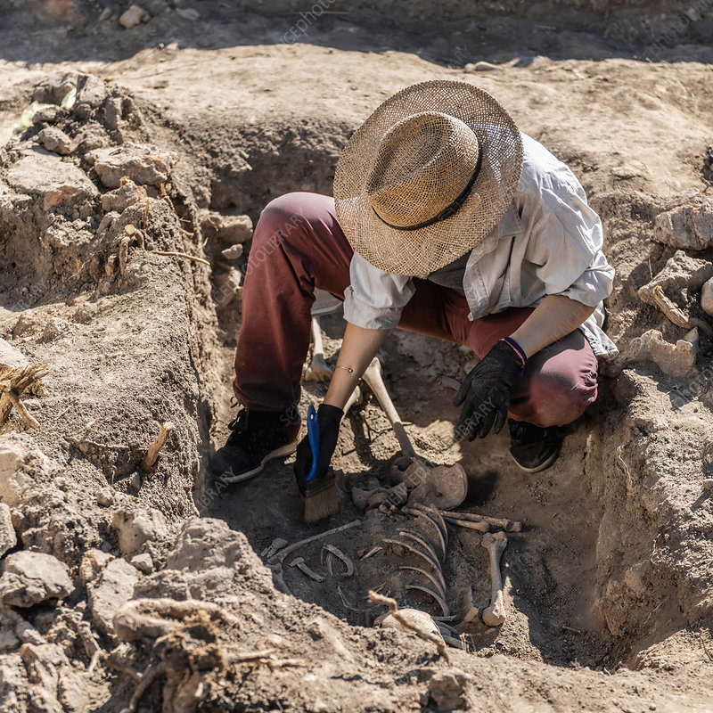
Archaeologist!

Slide 23

Solicitor!

Slide 24


Police Detective!

Slide 25
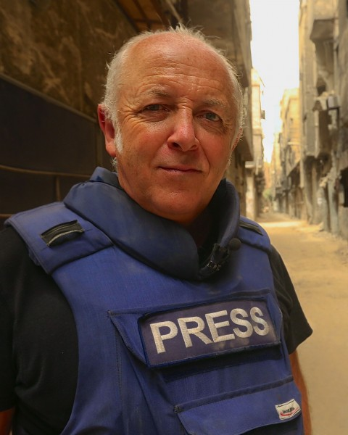
Journalist!

Slide 26

DIPLOMAT!

Slide 27

STOCKBROKER!

Slide 28
WHAT
do all these people have in common?

Slide 29
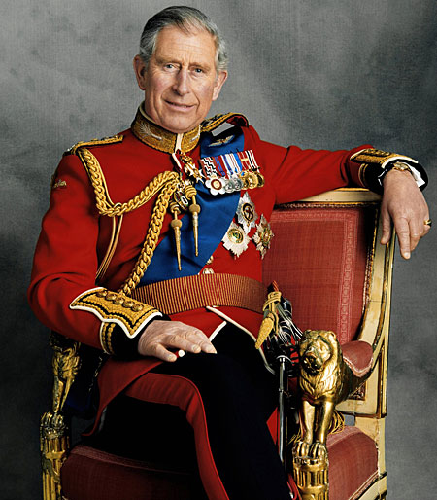
HRH King Charles III?

Slide 30
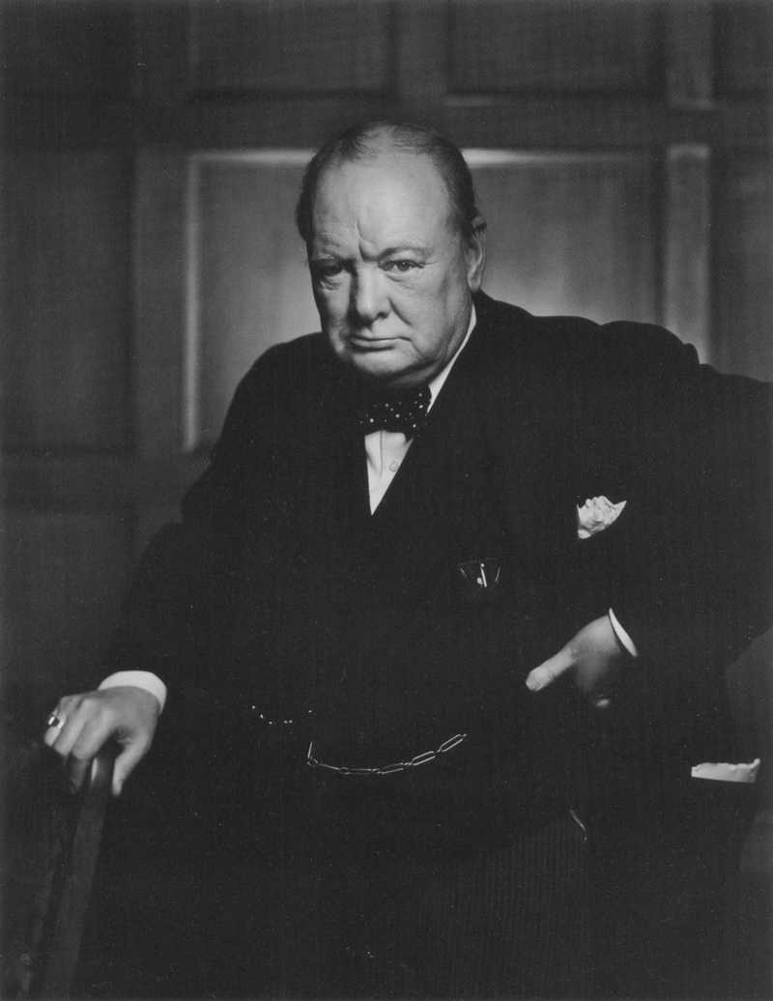
Prime Minister Winston Churchill?

Slide 31
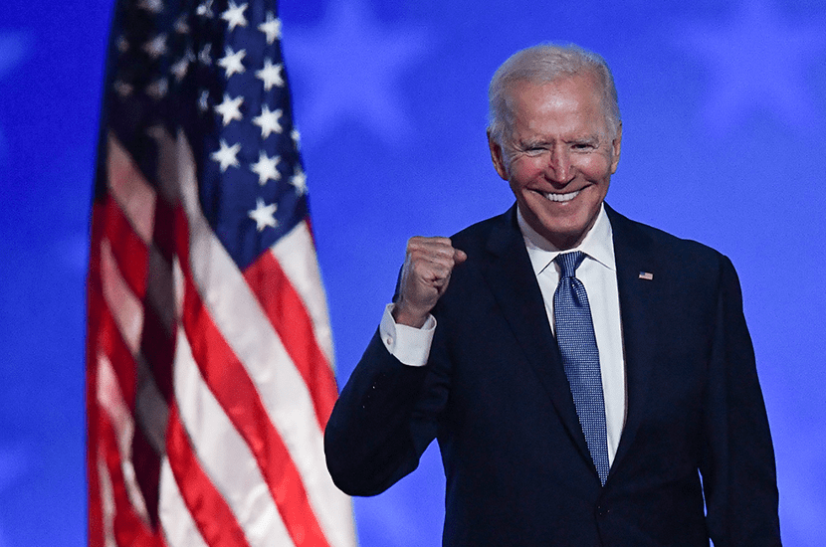
46th US President Joe Biden?

Slide 32
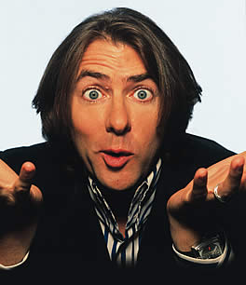
TV Presenter Jonathan Ross?

Slide 33
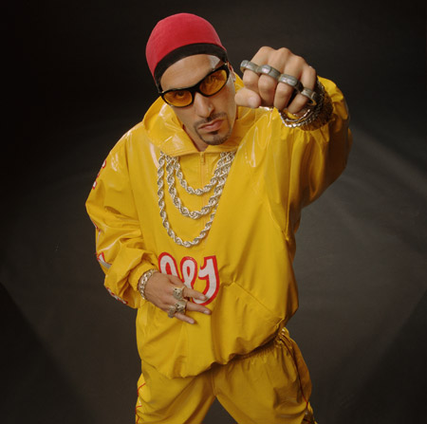
Comedian Ali G?

Slide 34
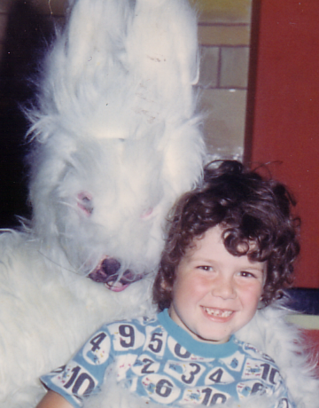
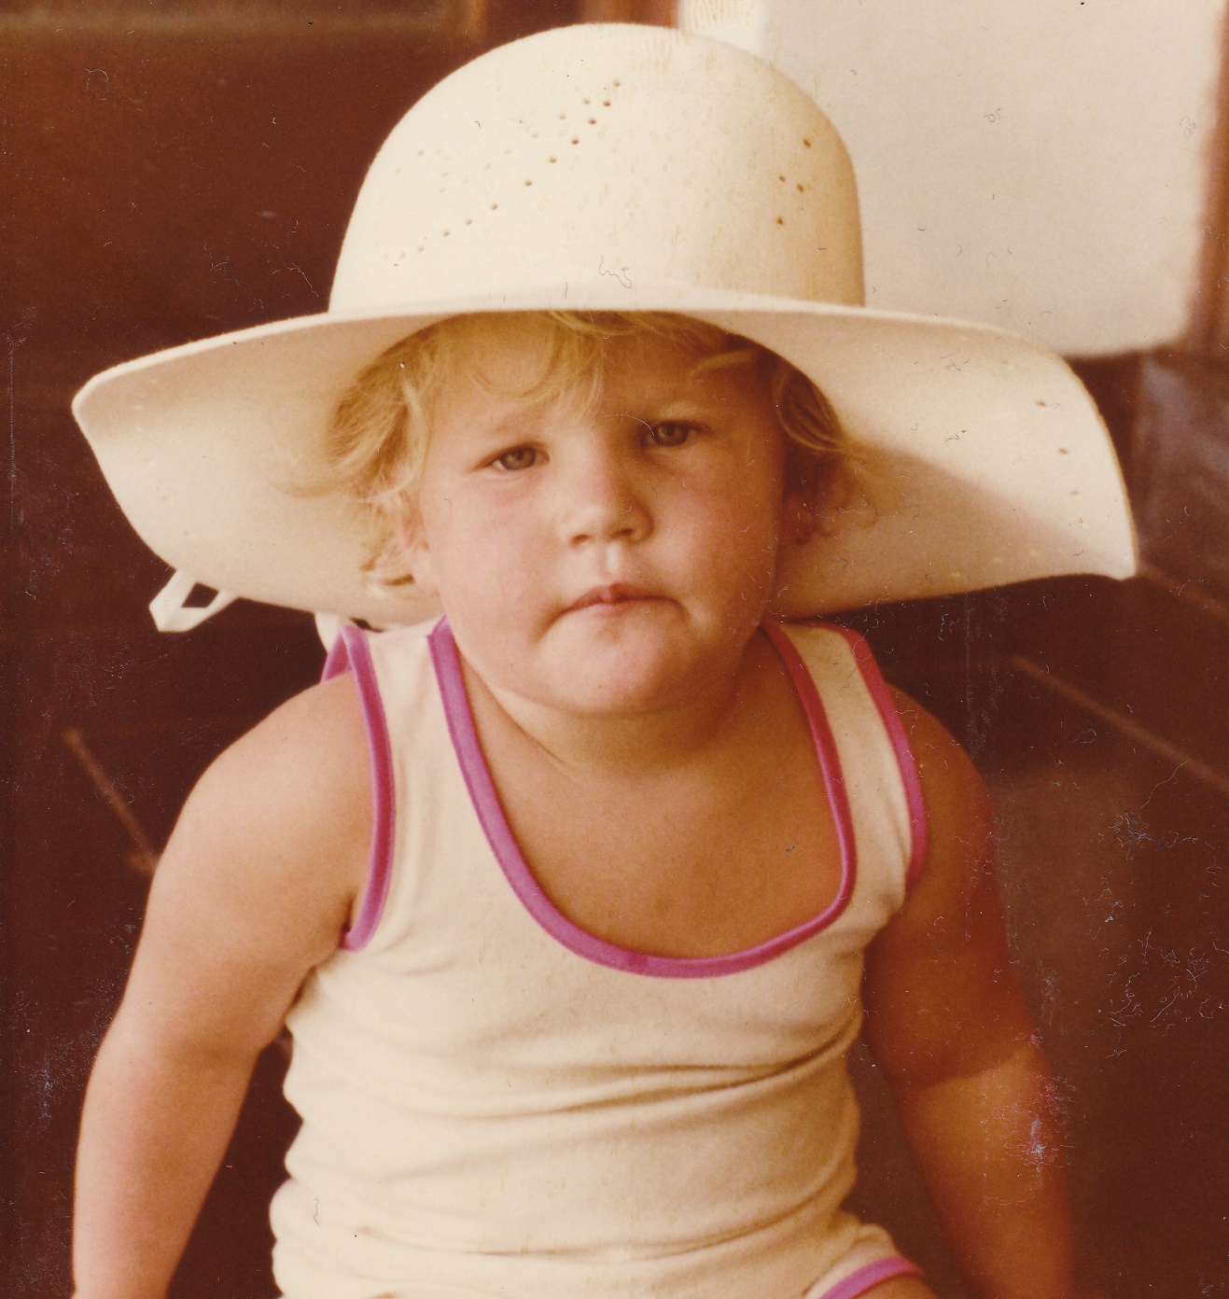
Uber Teachers
Mr Watson?
Mrs Sadler?

Slide 35
ANSWER
They ALL studied HISTORY!

Slide 36


Slide 37
SHiFT
HAPPENS!

Slide 38
NOW YOU
KNOW!

Slide 39
CHOOSE
GCSE HISTORY!

